Slide 1
Lecture 3: Gompertz filter
April 5, 2016
Notes:
density dependence
bare minimum to say there's density dependence?
per capita pop change is a function of population size

Slide 2

Directed random walk
$$x_{t+1}=x_{t}+ε_{t}$$
$$ε_{t}\sim Normal(α,σ_{x}^{2})$$
$$log⁡(y_{t})\sim Normal(x_{t},σ_{y}^{2})$$
Time-series follows a random-walk with a trend $α$
Notes:
How to insert density dependence here?
One way—put dependence in alpha (of normal) alpha is function of x

Slide 3
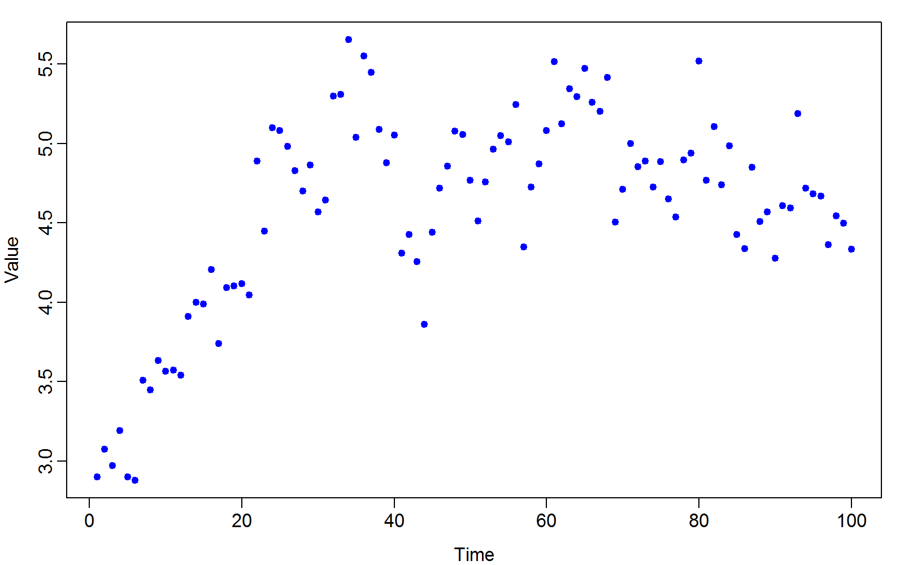
Data set
Notes:
How to say whether there’s density dependence here?
Eyeball looks like there’s a K…
Parametric approach = compare two models with and without density

Slide 4
Questions
Is there evidence of density dependence?
If yes, what is the expected equilibrium?
What is the stationary distribution?
Variance
How “stable” is the model
Reactivitiy
Resilience
Resistence

Slide 5
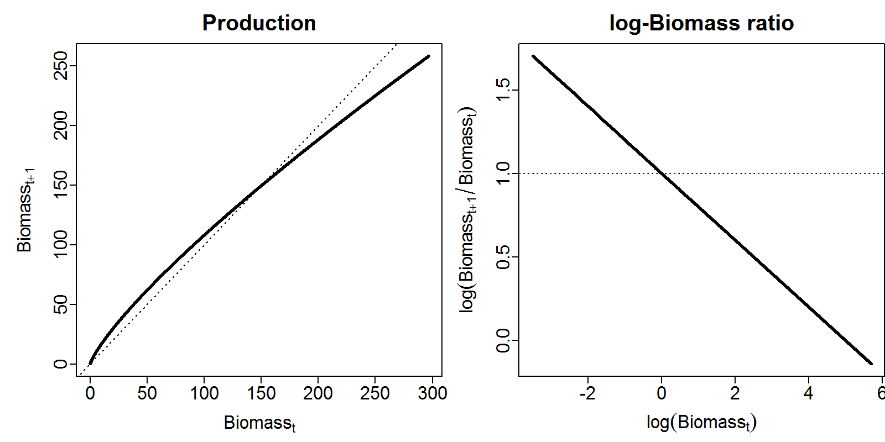

Gompertz model
$$d_{t+1}=d_{t}\exp\left(α−β{log⁡(d}_{t})+ε_{t}\right)$$
$$ε_{t}\sim Normal(0,σ_{d}^{2})$$
$$log⁡(b_{t})\sim Normal\left(log⁡(d_{t}),σ_{b}^{2}\right)$$
Notes:
Log space-log of first long– alpha – beta*log(dt) is the new mean alpha from before
Linear increase in log ratio of biomasses
On RHS beta controls the slope, alpha controls the intercept (i.e., K)
Eplison_t is process error (other stuff we’re not bothering to model)
B_t is the index of biomass
Pros and cons of this model?
Con? Super fast early growth rate
Pro?
How does this revert to a directed random walk?
When beta = 0, no density dependence and model can follow a random walk
Alpha is just the same alpha as before, the population growth rate (trending up or down over time)

Slide 6
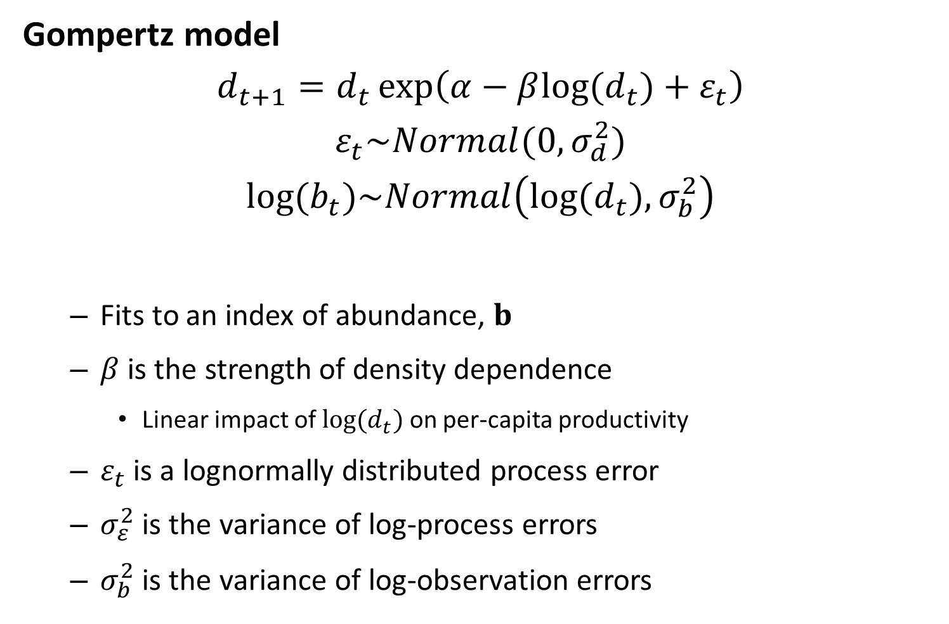
Gompertz model
$$d_{t+1}=d_{t}\exp\left(α−β{log⁡(d}_{t})+ε_{t}\right)$$
$$ε_{t}\sim Normal(0,σ_{d}^{2})$$
$$log⁡(b_{t})\sim Normal\left(log⁡(d_{t}),σ_{b}^{2}\right)$$
Fits to an index of abundance, $b$
$β$ is the strength of density dependence
Linear impact of ${log⁡(d}_{t})$ on per-capita productivity
$ε_{t}$ is a lognormally distributed process error
$σ_{ε}^{2}$ is the variance of log-process errors
$σ_{b}^{2}$ is the variance of log-observation errors
Notes:
Plug in alpha/beta as K, then we get alpha

Slide 7
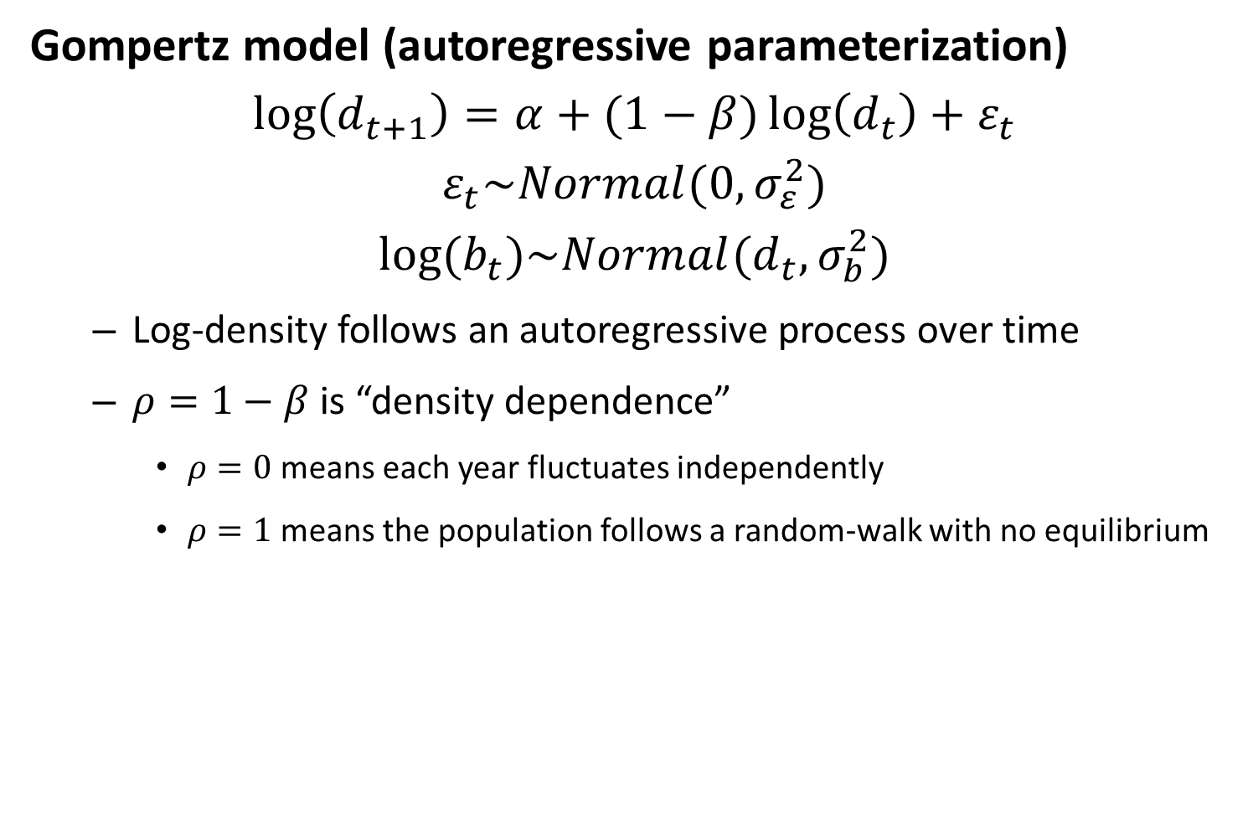
Gompertz model (autoregressive parameterization)
$$\log\left(d_{t+1}\right)=α+(1−β)\log\left(d_{t}\right)+ε_{t}$$
$$ε_{t}\sim Normal(0,σ_{ε}^{2})$$
$$log⁡(b_{t})\sim Normal(d_{t},σ_{b}^{2})$$
Log-density follows an autoregressive process over time
$ρ=1−β$ is “density dependence”
$ρ=0$ means each year fluctuates independently
$ρ=1$ means the population follows a random-walk with no equilibrium
Notes:
If log(dt) goes to negative infinity…doesn’t make sense at extremes
Define rho = 1-beta, same as directed walk but with autoregressive term
This is the simplest biological model that’s equivalent to a time series model
Linear in log space
If rho = -1, then beta > 0 and we get some oscillatory stuff
Beta = 1 → no density dependence

Slide 8
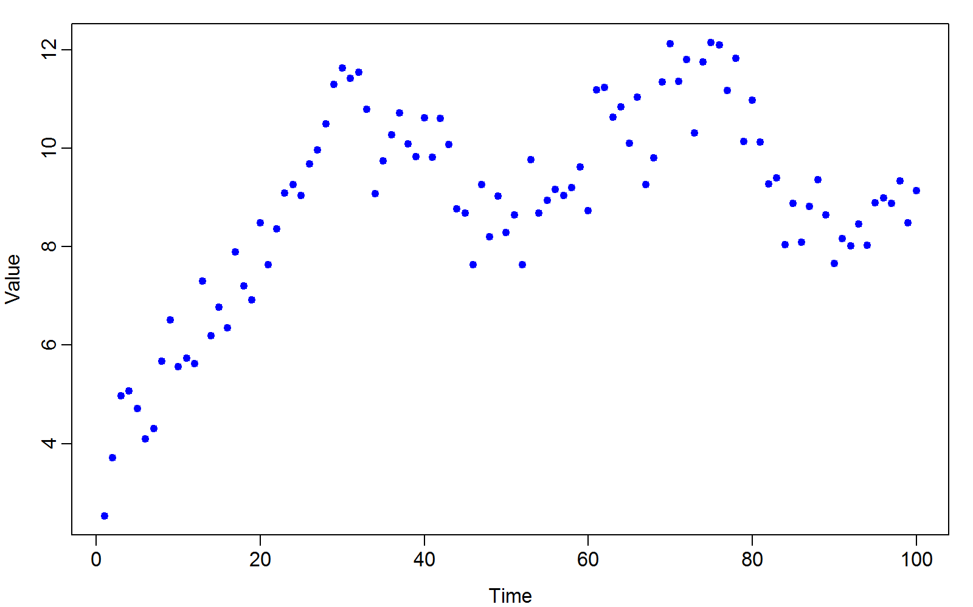
Gompertz model (autoregressive parameterization)

Slide 9
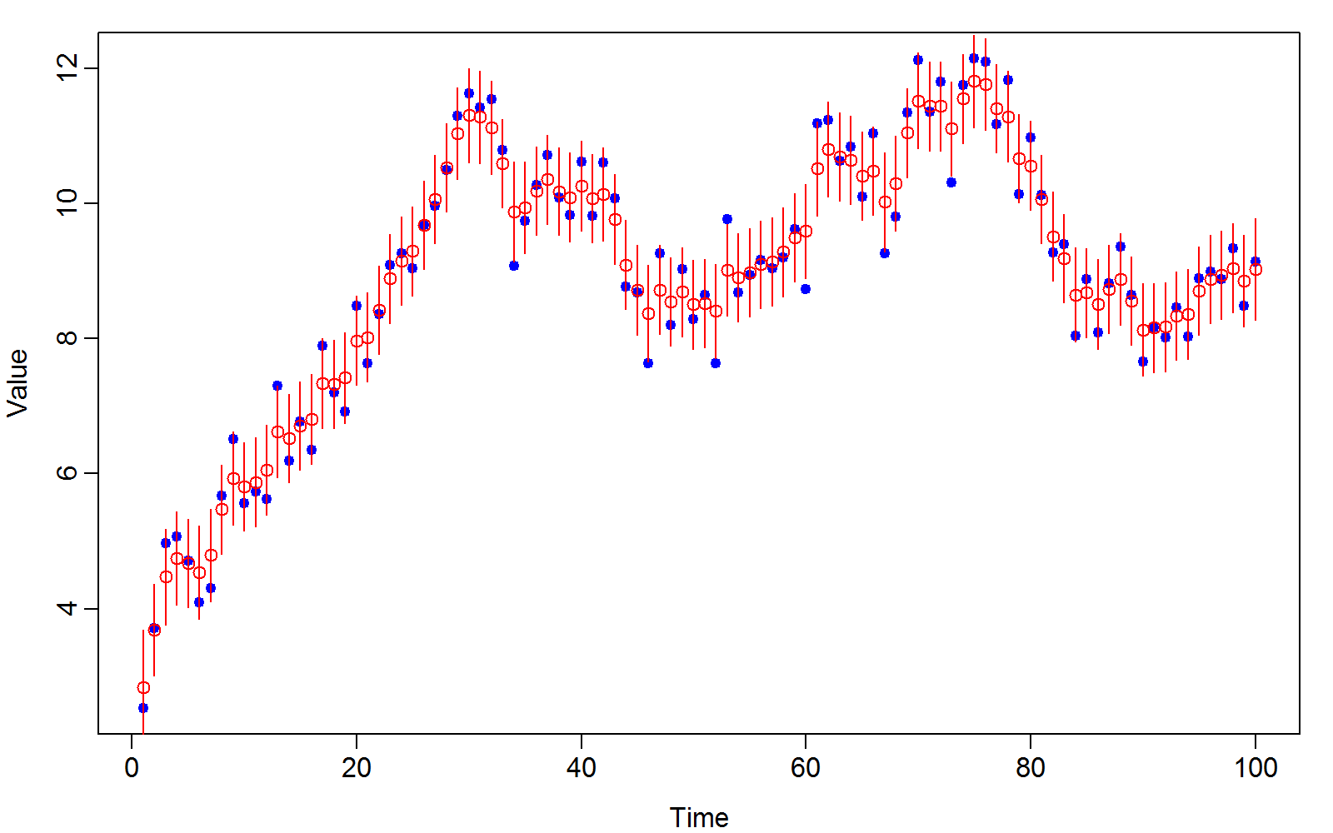
Gompertz model (autoregressive parameterization)

Slide 10
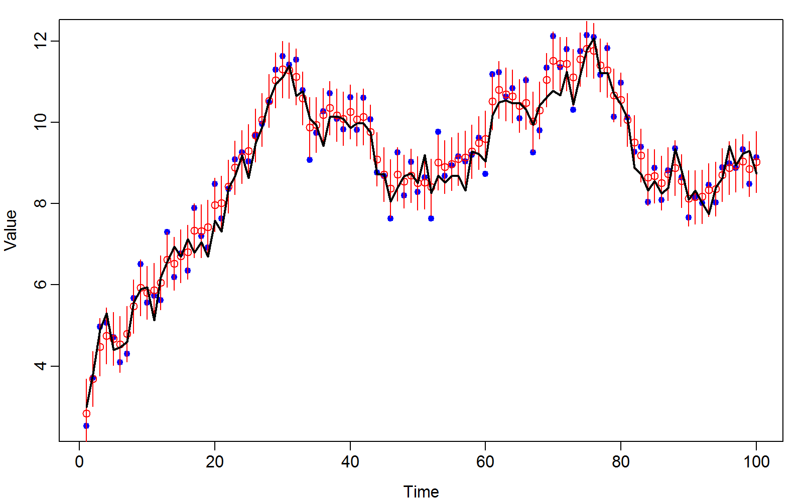
Gompertz model (autoregressive parameterization)

Slide 11
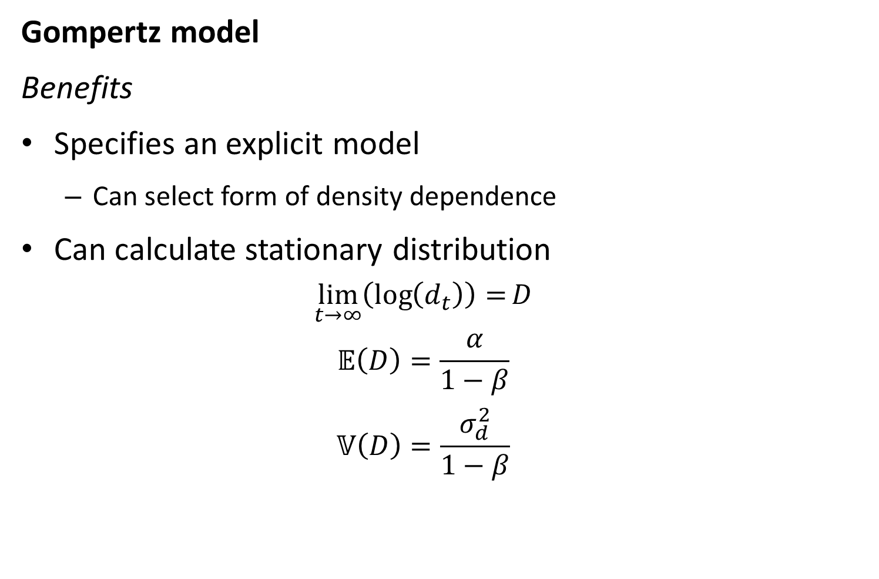
Gompertz model
Benefits
Specifies an explicit model
Can select form of density dependence
Can calculate stationary distribution
$$\lim_{t→∞}\left(\log\left(d_{t}\right)\right)=D$$
$$𝔼\left(D\right)=\frac{α}{1−β}$$
$$𝕍\left(D\right)=\frac{σ_{d}^{2}}{1−β}$$
Notes:
Stationary distribution = carrying capacity
Solve for E(D) with power series expansion??
Expectation of stochastic process….
Define for expectations like you would a deterministic system…
Simulate and look at it…
Only convergent when -1 < rho < 1, and that’s when the power series expansion actually works. Outside that, it becomes oscillatory.

